Slide 1
Dark patterns & persuasion CSCI 3002 Fall 2018
Notes:
http://homrj.files.wordpress.com/2009/12/cat8_gallery__394x4000.jpg

Slide 2
Where we are
We’ve practiced in designing interactive systems: sketching, prototyping
Rules of good design: models of usability, visual design
By now you should be capable of turning an idea or specification into an interactive prototype, leveraging some design strategies and avoiding pitfalls

Slide 3
Quiz on Friday
During recitation if you are here
There will be a backup (online) for people who cannot be physically present

Slide 4
Clickers today
We’re going to do some discussion about design problems
Actually going through the process of thinking about it is part of the learning process
So for these activities we’re going to try something different:
We’ll talk
You click in an answer
I’ll call on some people we don’t usually hear from

Slide 5
Considering different perspectives on “user-centered” design
Our user-centered design process to date:
Identify who the users are
Understand their goals
What happens when the users and goals are not what we expect?
Stakeholders and non-targeted use: users may be different than who we expect, may use things differently than we suspect

Slide 6
Perspectives
Users vs. stakeholders
Tensions between user groups
Non-targeted use

Slide 7
Users vs. stakeholders (or primary vs. secondary users)
The primary user is often not the only person who interacts with a computing system
Consider a new electronic door lock system for CU dorms
Who is the primary user?
Who else might interact with the system?
Who might have a broader stake in the system?
Talk with your neighbor and click in with your clicker when you have an answer

Slide 8
Lock users and stakeholders
Primary users
Students
Infrequent users
Friends
RA?
Cleaning staff
Campus police
Stakeholders far away
Parents
Insurance
University admin
Marketing
Company / maintenance
Non-targeted use
Burglar / crime
Notes:
Examples: students, the university, parents, cleaning staff,

Slide 9
When are we customers?
“If you’re not paying for it, you’re not the customer; you’re the product being sold.”
— Andrew Lewis
Notes:
https://www.metafilter.com/95152/Userdriven-discontent#3256046

Slide 10
Tensions between user groups
Users may have different priorities and goals
Sometimes these are mutually incompatible
Tools used by parents and kids
Designing un-cheatable electronic quizzes
How should we think about addressing these issues?

Slide 11
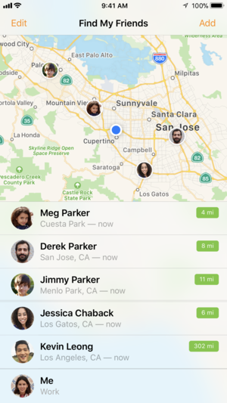
Group design problem
Consider a “Find my Friends” style app for parents and teenagers
What do both parents and kids want? Where do they differ?
How can we think about solving this problem?
Talk with your neighbor and click in with your clicker
Notes:
Find my iPhone image from Apple’s App Store

Slide 12
Addressing parents-child relationships
Happy medium between parents & kids
Less info to share, but enough
Set schedules & report back if they’re broken
Leverage shared secret
Visibility/transparency of observation
Tie to curfew / other rules

Slide 13
Some strategies
One goal may be to find a mutually acceptable solution
Balance benefits vs. drawbacks: what does each user gain?
Try to find breaking points around disagreements
“It’s OK if my kid stays out after school, but not after dark.”
Try to understand the feelings behind disagreements
Kids: Desire to make their own decisions, engaging in behaviors that parents might not like (in differing degrees)
Parents: Fear about kids getting into a bad place, desire to build trust and responsibility
We’ll discuss these kinds of trade-offs more in the future

Slide 14
Non-targeted use
Some users will find unexpected uses for your technology
Some may even use your technology for nefarious purposes!
It’s helpful to consider non-targeted use, and observe over time
Notes:
Here is an example where the feature was integrated! kinda cool

Slide 15
Non-targeted use
What are some ways that we use smartphones that were not originally intended?

Slide 16
Non-targeted smartphone uses
Tracking
Hold stuf down
Universal remote
Straight edge / rule
Mirror
Flashlight
Calculator
TV
Wallet
Drone
Weapon
Fidget toy

Slide 17
Why we care about non-targeted use
Non-targeted use may reflect unmet needs in the system
Sometimes may be undesirable behaviors (e.g. can Find my Friends be used to stalk people?)

Slide 18
Making things difficult
Are there times when we want to make a task more difficult to perform?
Notes:
Car image: http://blog.toyotaofnorthcharlotte.com/wp-content/uploads/2015/11/parking-brake.png
Pills: https://qz.com/796794/clearrx-people-are-digging-through-their-trash-to-save-targets-well-designed-prescription-pill-bottles/
Note these are different!

Slide 19
Making things difficult
There are various reasons why we might make something difficult to do
Notes:
Car image: http://blog.toyotaofnorthcharlotte.com/wp-content/uploads/2015/11/parking-brake.png
Pills: https://qz.com/796794/clearrx-people-are-digging-through-their-trash-to-save-targets-well-designed-prescription-pill-bottles/
Note these are different! One is about making an action difficult to perform accidentally; the other is to protect against certain users
For things like deleting files, we might want to allow it, but allow undo

Slide 20
Different kinds of restrictions
Making some tasks difficult to perform
Especially tasks that are irreversible, destructive, etc.
Good HCI practice is to make things easy to do AND easy to undo; this isn’t always possible
Restrict who can perform a task
But this can cause unexpected barriers
e.g. adults == tall, put fun adult stuff (🍺🍷🍸) up high

Slide 21
Next up
How to be evil
Notes:
As we all know, the Injustice League is the inverted bad guys

Slide 22
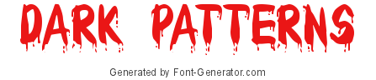
No seriously
How can we use what we know about good design practices to misdirect or influence users?
We call these
(following from Christopher Alexander’s design patterns)
Notes:
https://www.font-generator.com/fonts/Bloody/

Slide 23
Design noir
Future-facing design activities that follow the assumption that people will be awful and the worst will happen
Why do this?
Once something is out in the world, we don’t have control over it
Sometimes people are awful
Important to conduct threat assessments ahead of time

Slide 24
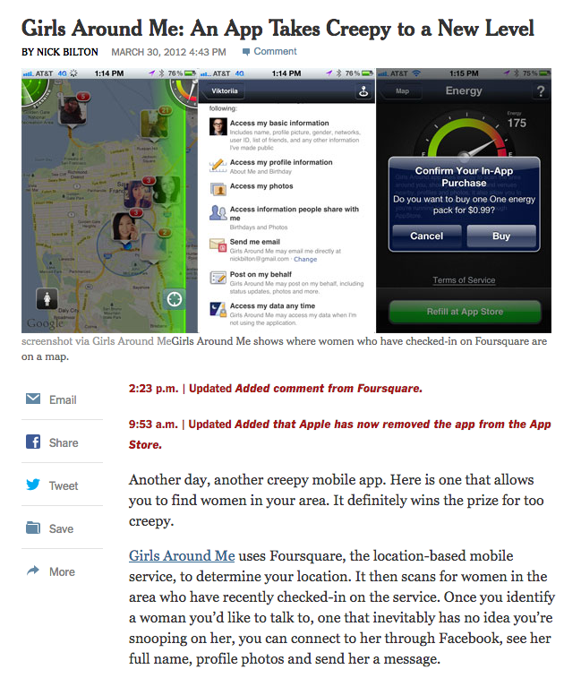
Notes:
Creepy stuff does happen.
https://bits.blogs.nytimes.com/2012/03/30/girls-around-me-ios-app-takes-creepy-to-a-new-level/

Slide 25
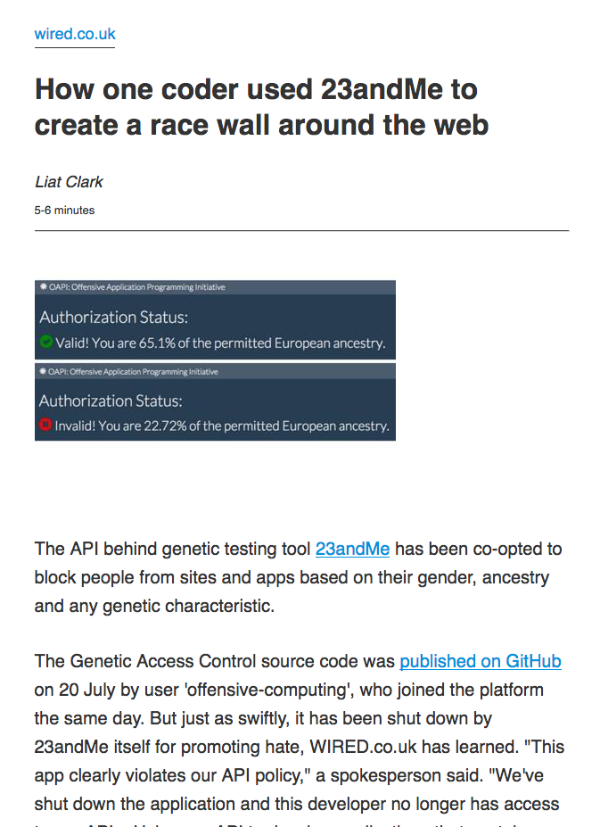
Notes:
https://www.wired.co.uk/article/23andme-api-blocks-based-on-race-gender

Slide 26
Dark patterns
How designers are currently doing things that are misleading, deceptive, manipulative
Often these strategies are developed in one place and then spread across other sites / apps
Notes:
Design noir is often more about future use.

Slide 27
Why study dark patterns?
Protect ourselves against misdirection
Learn from highly motivated designers (whose motives are often knowable)
Flex our design muscles
Notes:
People who do this stuff have clear reasons, so they want to do it well!
Photo: Alan Rickman as Snape in Harry Potter…

Slide 28
Examples
What are some examples of deceptive / manipulative patterns in existing UI?

Slide 29
Dark pattern examples from our experiences

Slide 30
What are some goals of dark pattern practitioners?
Keep you locked in
Make you think something else is happening
Redirecting you to some other task
Being misleading about what is required
Changing difficulty
Bundling unrelated items
Hiding the choices
Notes:
Usually to make money! But how?

Slide 31
How dark patterns work
Rather than supporting a user in achieving their own goals, guide the user to a specific goal
While maintaining the illusion of choice
Draw the user’s attention to a particular choice
Miscommunicate the outcome
Often misuse good usability practices
Notes:
https://twitter.com/chillfinn/status/872389496737861633/photo/1

Slide 32
Misdirecting user attention
Notes:
Both of these break the same rule about expecting what a button will do, and following line of sight.
Left: https://twitter.com/chillfinn/status/872389496737861633/photo/1
Right: https://twitter.com/kristinalustig/status/874986152012505088/photo/1

Slide 33
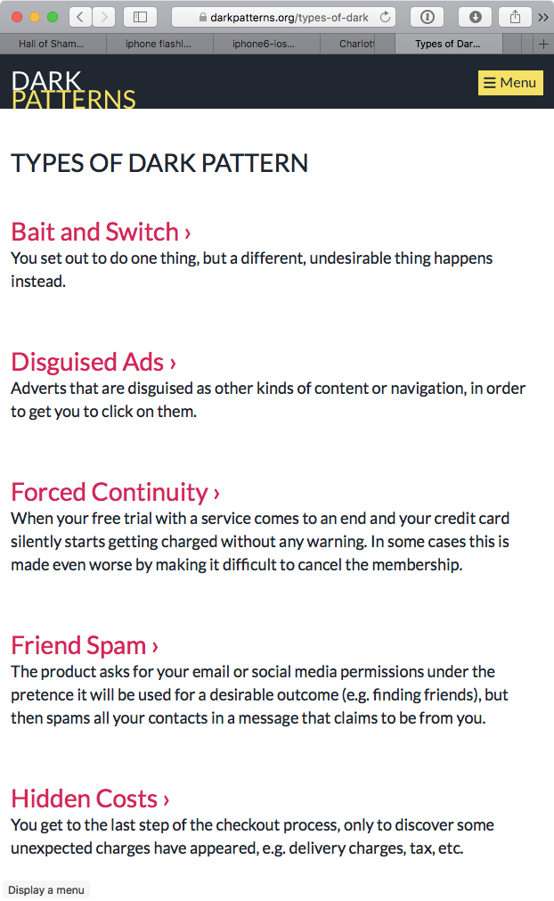
Understanding dark patterns
Growing collection of examples at darkpatterns.org
Many techniques for misdirecting users
We’ll discuss some highlights, but there are many more
Notes:
https://darkpatterns.org/types-of-dark-pattern

Slide 34
Example dark patterns

Slide 35
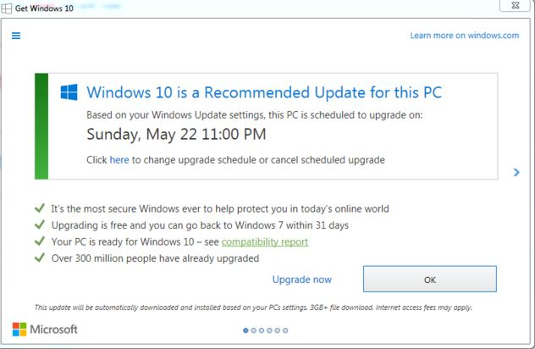
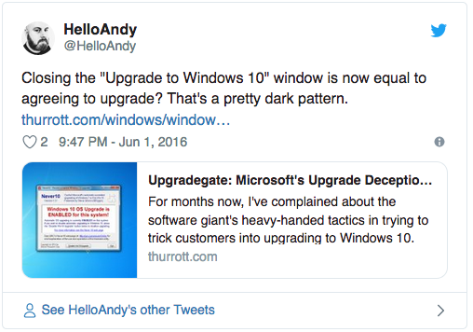
Bait and switch
The user expects one outcome but actually another is happening
Notes:
In this case, both options will cause the update to happen.

Slide 36
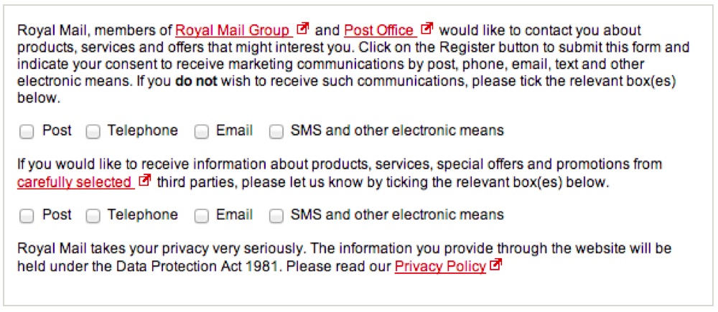
Trick questions
Question appears to be asking one thing, but it’s asking something else
Notes:
In this case, the first Q is opt-out and the second is opt-in

Slide 37
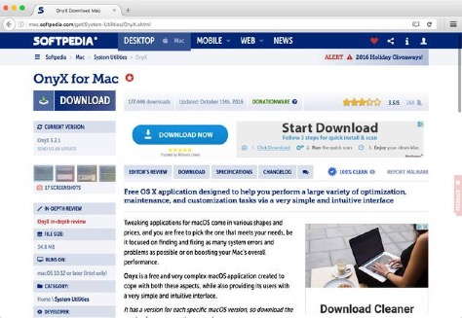
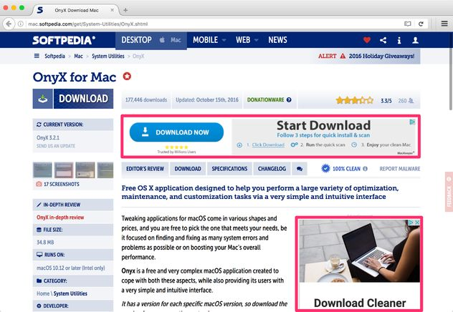
Disguised ads (and other bad stuff)
Notes:
This example always reminds me of biomimicry – ads have evolved to look like functional buttons.
https://darkpatterns.org/types-of-dark-pattern/disguised-ads

Slide 38

Confirm shaming
Make it difficult or unpleasant to confirm a difficult choice
Notes:
http://confirmshaming.tumblr.com/

Slide 39
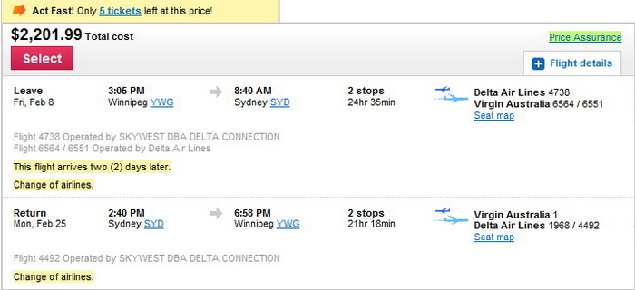
Perceived scarcity
Encourage a choice now, before it is too late
Notes:
http://www.cleanmpg.com/community/index.php?threads/44707/

Slide 40
How to make our own dark patterns
We can learn the basics of dark patterns by inverting our good patterns
Make important actions clear → make desired actions clear (and hide others)
Make system status visible → hide or mislead about system status
Recognition rather than recall → require users to perform complex steps to perform undesired actions
Notes:
We can invert Nielsen’s usability heuristics.

Slide 41
What to do about dark patterns
Be aware and informed
Make sure your designs are clear and not misleading
Sometimes these same issues come up by accident
Be intentional about when you are encouraging a specific outcome

Slide 42
Dark patterns in the physical world
Notes:
Left: Williams and Graham bar door, from https://lifeandthyme.com/wp-content/uploads/2016/01/williams-and-graham-16-669x1024.jpg
It’s hiding the affordance! In this case, this is intended for fun.

Slide 43
Further reading
https://darkpatterns.org/
https://twitter.com/darkpatterns
https://www.youtube.com/watch?v=kxkrdLI6e6M
https://uxplanet.org/5-common-ux-dark-patterns-and-user-friendly-alternatives-6c8c2f127242
https://uxdesign.cc/dark-patterns-in-ux-design-7009a83b233c
https://www.theverge.com/2013/8/29/4640308/dark-patterns-inside-the-interfaces-designed-to-trick-you

Slide 44
Activity
Let’s design interfaces to manipulate users
We’ll manipulate a course search page to:
Encourage or discourage students to sign up for more courses
Encourage students to sign up for CSCI courses
Encourage students not to over-enroll

